Slide 1
Is the Dataset Biased?

Slide 2
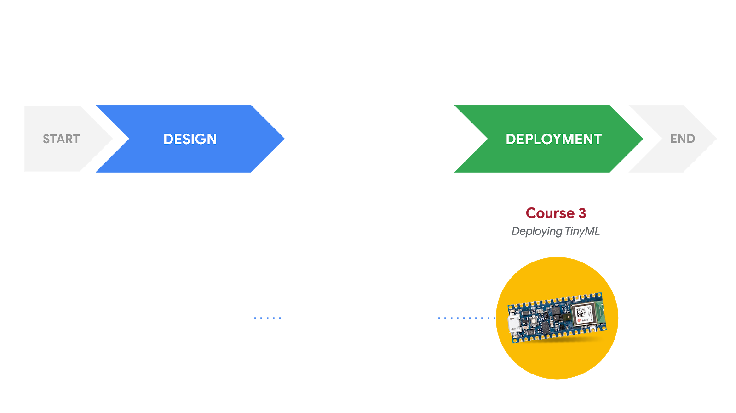
Responsible AI: Human-Centered Design
DEVELOPMENT
Course 1
Fundamentals of TinyML
Course 2
Applications of TinyML
What am I building?
Who am I building this for?
What are the consequences for the user if it fails?
What data will be collected to train the model?
Is the dataset biased?
How can we ensure the model is fair?

Slide 3
What is bias?
Bias is a deviation in a predictable (i.e., not random) direction

Slide 4
What is bias?
Bias is a deviation in a predictable (i.e., not random) direction
Not all errors
are attributed to bias

Slide 5
What does bias mean for ML?
Bias in machine learning = systematic errors that lead to inaccurate results
Biased datasets (faulty, poor, or incomplete data) can lead to a distribution mismatch between the dataset and reality
This may lead to inaccurate results, or worse, discriminatory or unfair results
Notes:
Datasets are expected to resemble the probability distribution of observations

Slide 6
The “garbage in, garbage out” problem
Input:
Bad Data
Perfect
Model
Output:
Bad Results

Slide 7
Bias: Defining the Target Variable
How should you define a “good” employee for a hiring algorithm?
Subjective process: “good” must be defined in ways that correspond to measurable outcomes
Number of sick days
Number of times late to work
Length of employment
Number of sales per quarter
Notes:
When you define the target variable, it’s best described as an art form rather than a perfect science. What is a good employee, and how can you put this in terms that a computer could parse/understand?
So we come up with some quantifiable measures.
But maybe you define this in ways that unintentionally disadvantages some class of people. (Poor people who use public transportation, or pregnant women or individuals with disabilities missing work)

Slide 8
Bias: Defining the Target Variable
How should you define a “good” employee for a hiring algorithm?
Subjective process: “good” must be defined in ways that correspond to measurable outcomes
?
Number of sick days
Number of times late to work
Length of employment
Number of sales per quarter
Notes:
When you define the target variable, it’s best described as an art form rather than a perfect science. What is a good employee, and how can you put this in terms that a computer could parse/understand?
So we come up with some quantifiable measures.
But maybe you define this in ways that unintentionally disadvantages some class of people. (Poor people who use public transportation, or pregnant women or individuals with disabilities missing work)

Slide 9
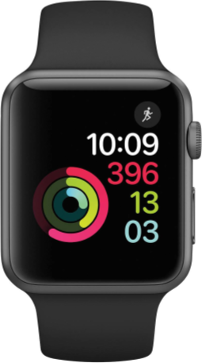
Bias: Defining the Target Variable
Using biometric sensors for a health wearable device, how should you define “healthy”?
Heart rate
Blood pressure
Number of steps
Notes:
Graphic reused from Ch.1

Slide 10
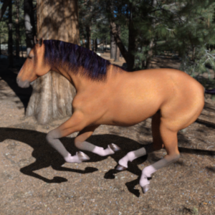

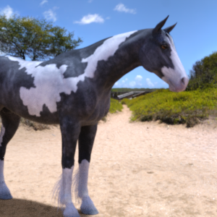
Bias: Labeling the Data
Labels applied to the training data must serve as ground truth
Horse
Human
Human
ERROR
Notes:
Images from 2-4-2 slides
Whatever decisions we get based off of badly labeled data will necessarily exhibit the same badness

Slide 11
Bias: Labeling the Data
Trained Graders
None
Mild
Moderate
Severe
Proliferative
Patient Images
Notes:
Which of the available labels best applies to a particular example? Even experts might disagree.

Slide 12
Bias: Labeling the Data
Trained Graders
None
Mild
Moderate
Severe
Proliferative
Patient Images
?
Notes:
Which of the available labels best applies to a particular example? Even experts might disagree.

Slide 13




Bias: Sampling the Data
Training Data
Notes:
Sample bias occurs when the distribution of one’s training data doesn’t reflect the actual environment that the machine learning model will be running in
https://commons.wikimedia.org/wiki/File:Emoji_u1f471_1f3fe_200d_2640.svg
https://commons.wikimedia.org/wiki/File:Emoji_u1f935_1f3fe.svg
https://commons.wikimedia.org/wiki/File:Emoji_u1f935_1f3fb.svg
https://commons.wikimedia.org/wiki/File:Emoji_u1f469_1f3fb_200d_1f4bc.svg
https://commons.wikimedia.org/wiki/File:Emoji_u1f469_1f3fe_200d_1f4bc.svg
https://commons.wikimedia.org/wiki/File:Emoji_u1f469_1f3fc_200d_1f4bc.svg

Slide 14




Bias: Sampling the Data
Training Data
Reality

Slide 15
Bias: Sampling the Data
Training Data
Reality

Slide 16
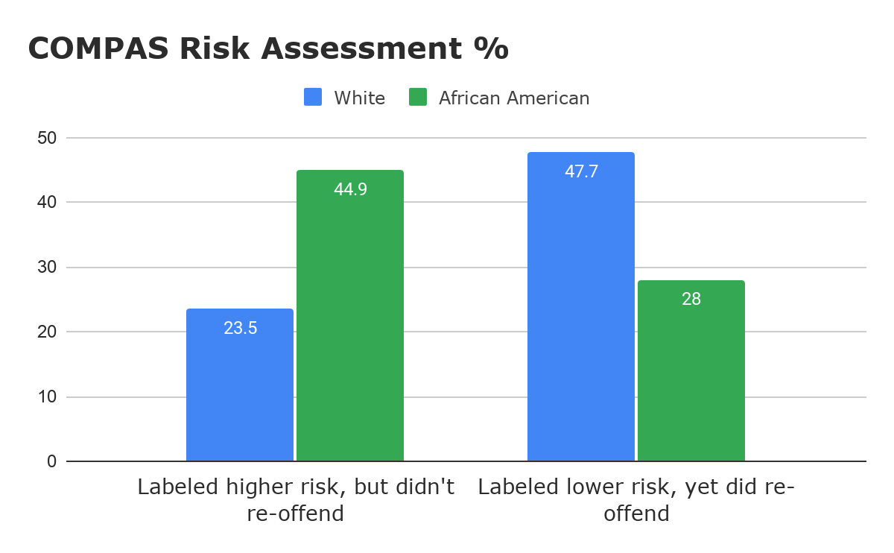
Bias: Prejudice Reflected in Data
Northpointe’s COMPAS Recidivism Prediction Tool
Notes:
Heavier policing in minority-dominated often inflate arrest statistics for individuals residing in those areas.21 As COMPAS is a statistics-based algorithm, this could make black defendants more prone to inordinately high-risk scores by virtue of where they live.
Overall, Northpointe’s assessment tool correctly predicts recidivism 61% of the time. But blacks are almost twice as likely as whites to be labeled a higher risk but not actually re-offend. It makes the opposite mistake among whites: They are much more likely than blacks to be labeled lower risk but go on to commit other crimes. (Source: ProPublica analysis of data from Broward County, Fla.)
Graph made by Professor

Slide 17
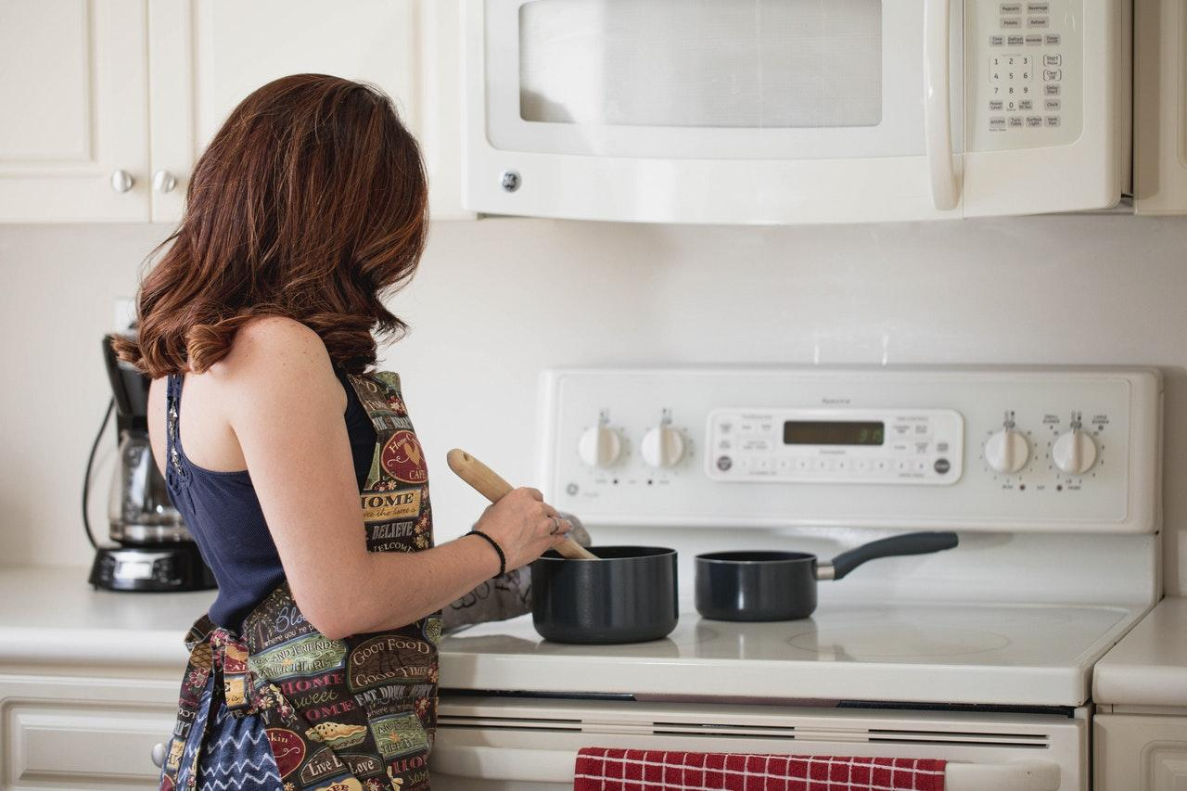

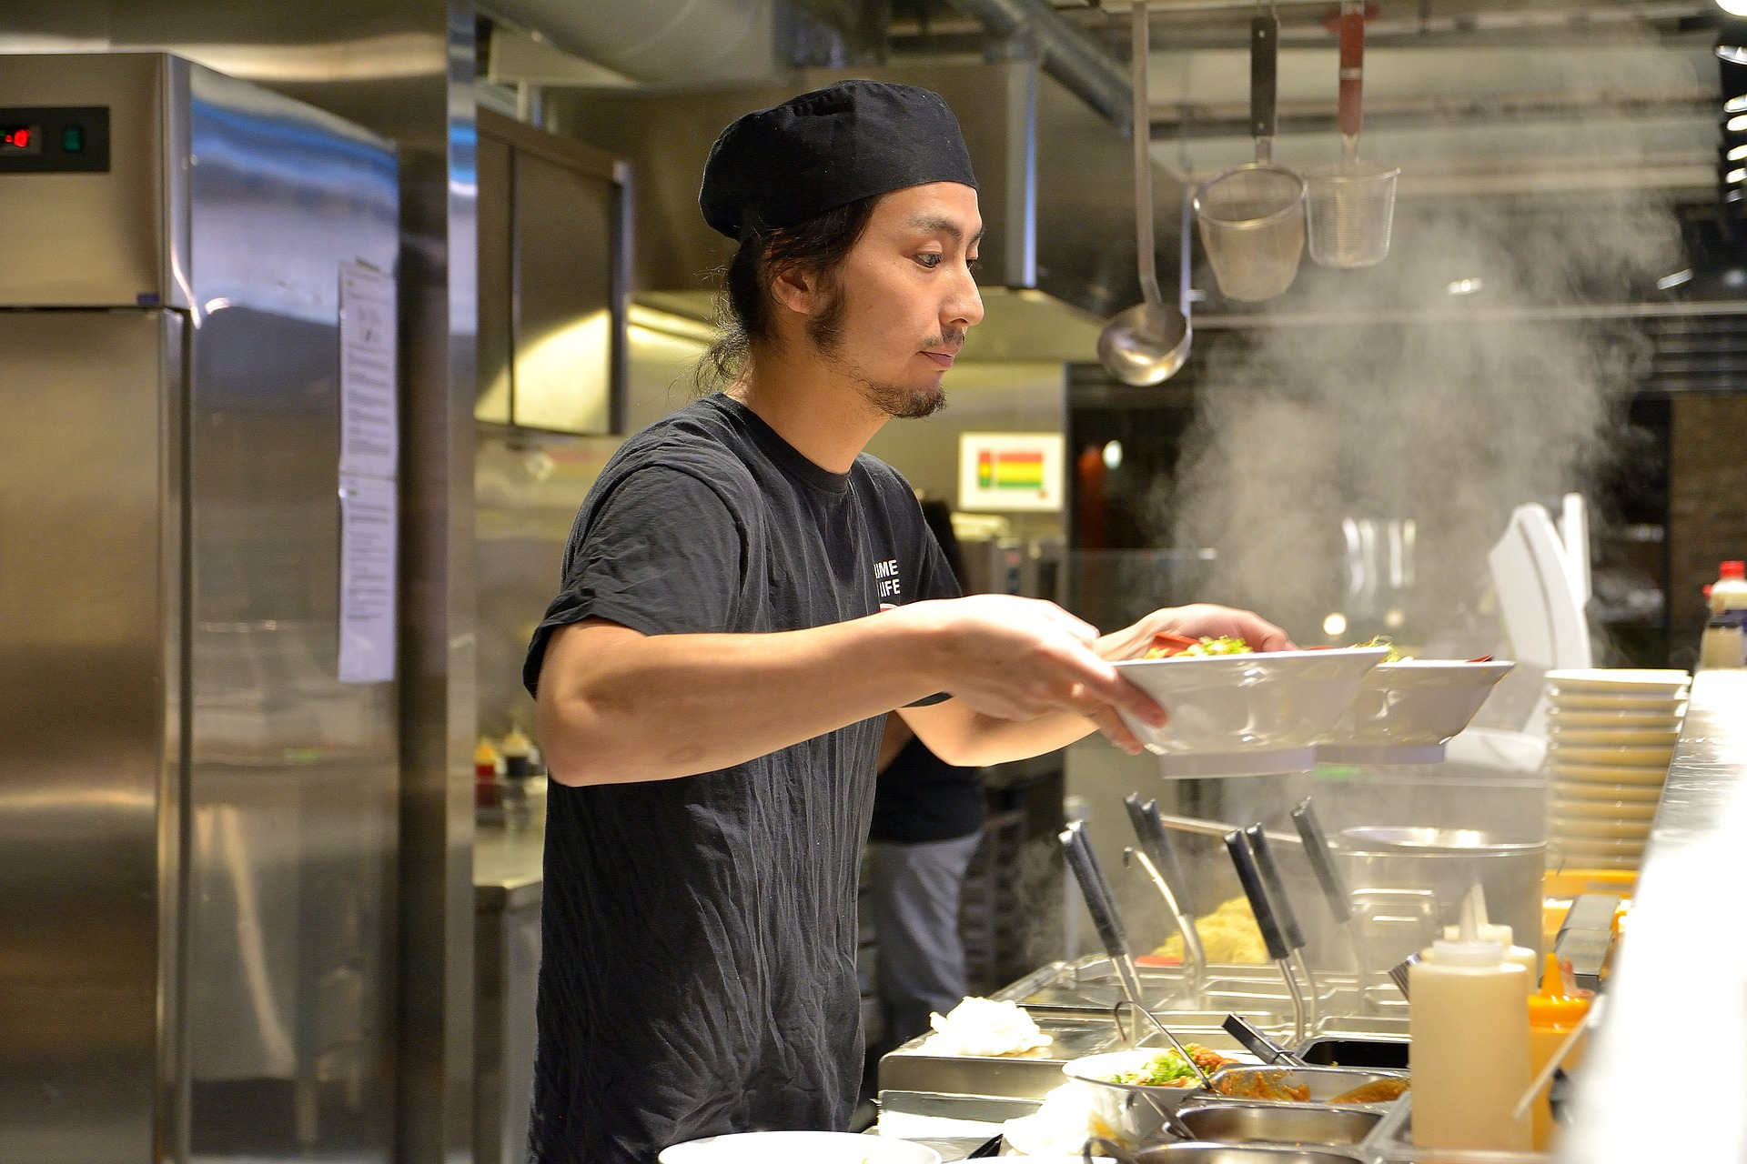
Bias: Prejudice Reflected in Data
Dataset: 65% of people cooking are women Algorithm predicts: 85% of people cooking are women
Notes:
Binary image classification - overfitting/proxy problems due to stereotypes
Unavailable or inaccurate data
Data scientist must control for this type of bias. There are a variety of ways to do this, either on the front-end of the project or on the back-end. You could choose to under sample the number of pictures of women in the kitchen, or oversample the number of men in the kitchen.
“You can also control for that by creating other features in the data or having a secondary [filter],” she says. “There’s lots of ways to control the input data, or do post-processing on the output. What technique you use may work equally well, but the trick is understanding that your distribution of your sample reflects something that you don’t want in your output.”
Picture 1: https://www.pexels.com/photo/woman-in-the-kitchen-preparing-to-cook-2890387/
Picture 2: https://pxhere.com/en/photo/1626697
Picture 3:
https://pixabay.com/photos/chef-serving-ramen-food-enjoy-4021815/

Slide 18

Bias: Measurement Distortion
Hardware matters!
Example: Optic sensors and cameras have problems detecting darker skin tones due to the way light is reflected
Automatic soap dispensers
Activity detection
Facial recognition
Notes:
Another source of bias in the data is systematic value distortion, which most often occurs when there’s a problem with the device making an measurement or an observation. This type of bias can skew the machine learning results in a particular direction.
“Imagine if your training data’s camera had a property that filters colors in some way. But the other cameras that you might have in your environment…are more accurate,” Martin says. “So if you have a systematic distortion of your color scheme from your measurement device, that can cause a bias in your data that will effect your output.”
If the problem is a general lack of precision in the data-gathering device, and an abundance of noise in the data, then it might average out over time, Martin says. But if the measurements are consistently skewed in one direction all the time, then it can wreak havoc with the data used for training the model, and ultimately generate a bad result.
Hazard symbol from Deck 1-3-7

Slide 19
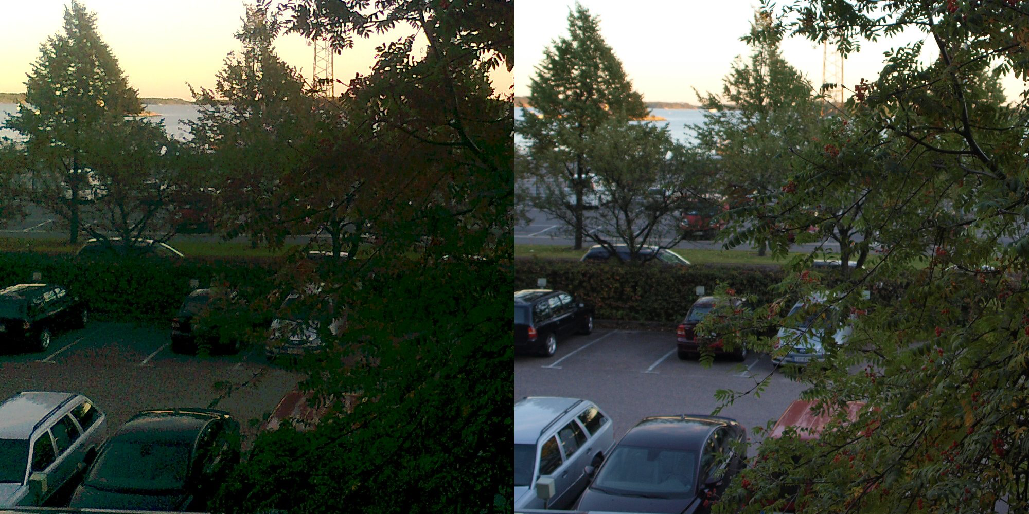
Bias: Measurement Distortion
Notes:
https://en.wikipedia.org/wiki/File:Phone_SLR_comparison_1.jpg
A comparison of the same scene photographed with a mobile phone (Nokia 6303i classic) and a DSLR camera (Olympus E-520). Both devices used automatic settings. The resulting photographs have been juxtaposed using GIMP.

Slide 20
How can we fix biased data?

Slide 21
Industry Solutions: Datasheets for Datasets
Questions for dataset creators to reflect on during the key stages of the dataset lifecycle:
Motivation
Composition
Collection Process
Preprocessing/ labeling
Uses
Distribution
Maintenance
paper authored by
TIMNIT GEBRU, Google
JAMIE MORGENSTERN, Georgia Institute of Technology
BRIANA VECCHIONE, Cornell University
JENNIFER WORTMAN VAUGHAN, Microsoft Research
HANNA WALLACH, Microsoft Research
HAL DAUMÉ III, Microsoft Research; University of Maryland
KATE CRAWFORD, Microsoft Research; AI Now Institute
Notes:
Paper Referenced: https://arxiv.org/pdf/1803.09010.pdf

Slide 22
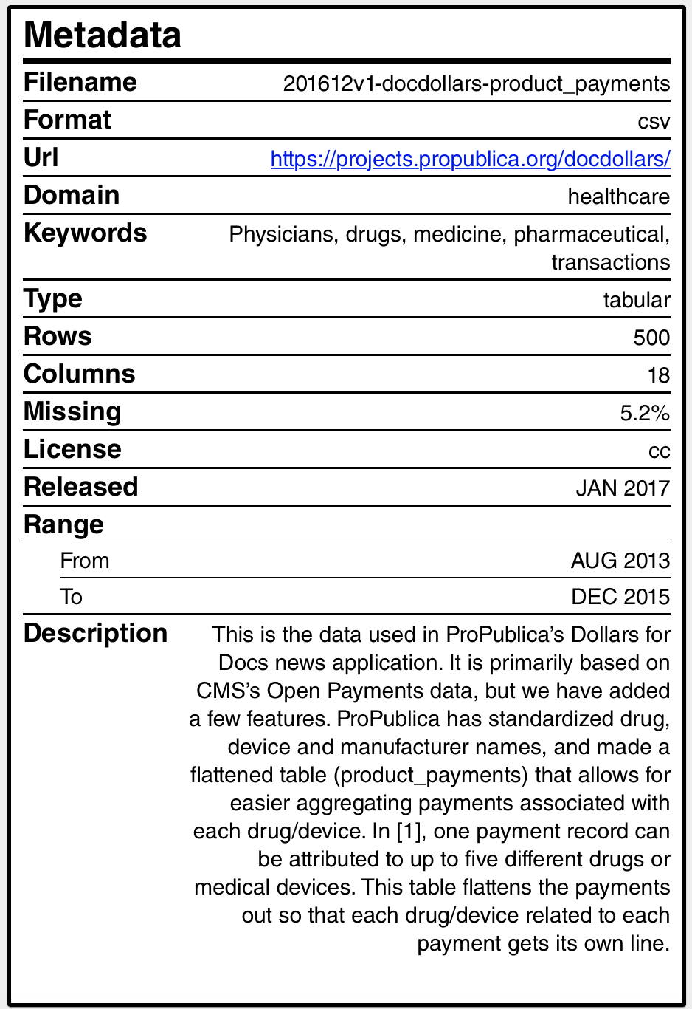

Industry Solutions: Data Nutrition Labels
A standard label that highlights the “key ingredients” of a dataset:
Provenance
Metadata
Missing units
Variables
Notes:
Logo from https://github.com/Data-Nutrition-Project/dnp-website (MIT License, so free to use)
Nutrition label: https://ahmedhosny.github.io/datanutrition/
(Creator’s page) https://github.com/ahmedhosny (we could probably reach out?)

Slide 23
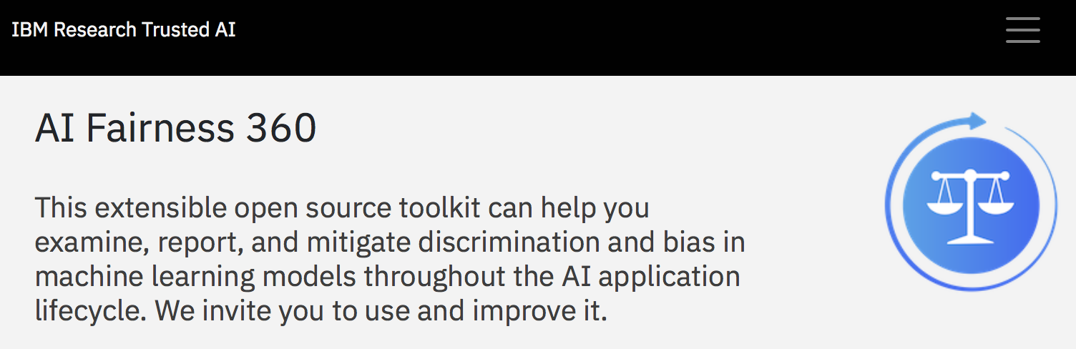
Industry Solutions: Bias Testing Toolkits
Notes:
Make bias testing a part of your development cycle. Google, IBM, and Microsoft have all released tools and guides to help with analyzing bias for a number of different data types
However, AI Fairness 360’s bias detection and mitigation algorithms are designed for binary classification problems that’s why it needs to be extended to multiclass and regression problems if your problem is more complex.
IMAGE SRC: https://aif360.mybluemix.net/?_ga=2.130485455.1744053973.1589509987-72020752.1588123896

Slide 24
Designer Solutions
Carefully research your users in advance, be aware of potential outliers
Ensure your team of data scientists and data labelers is diverse
Where possible, combine inputs from multiple sources to ensure data diversity
Create a gold standard for data labeling
Seek out domain experts to review your data

